Slide 1
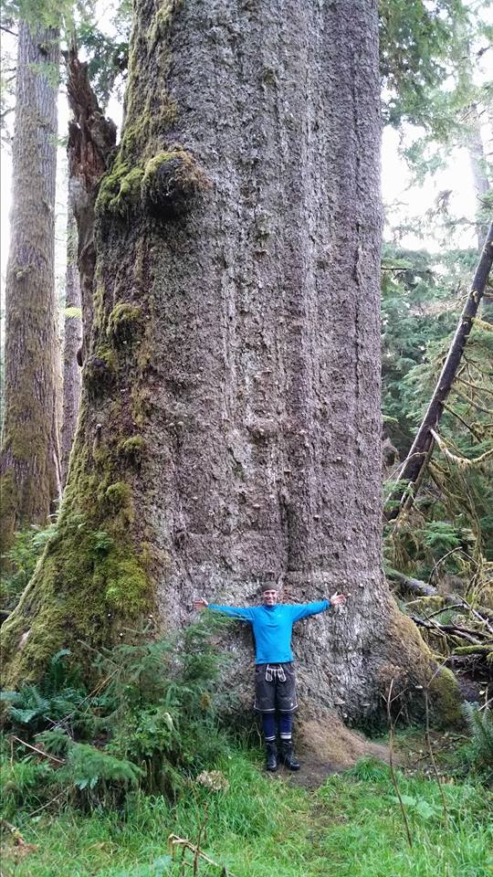
Haida Nation

Slide 2
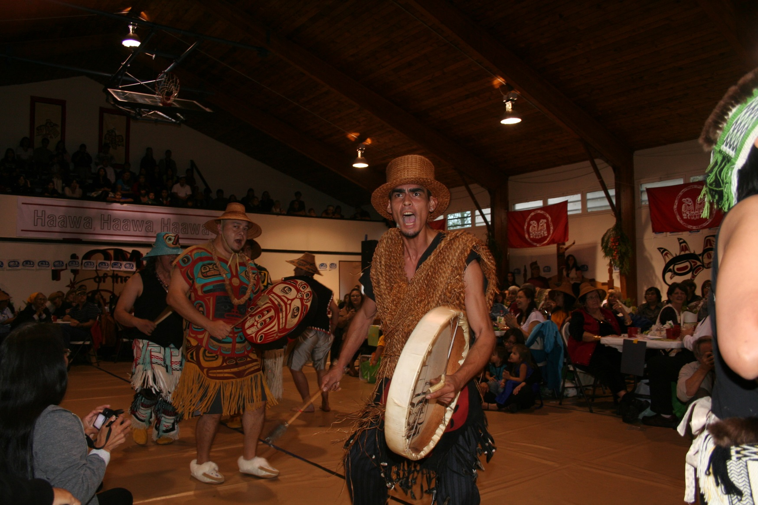
-1774 first contact
-1853 first foreign permit issued
-1862 disease
-1985 Athlii Gwaii

Slide 3
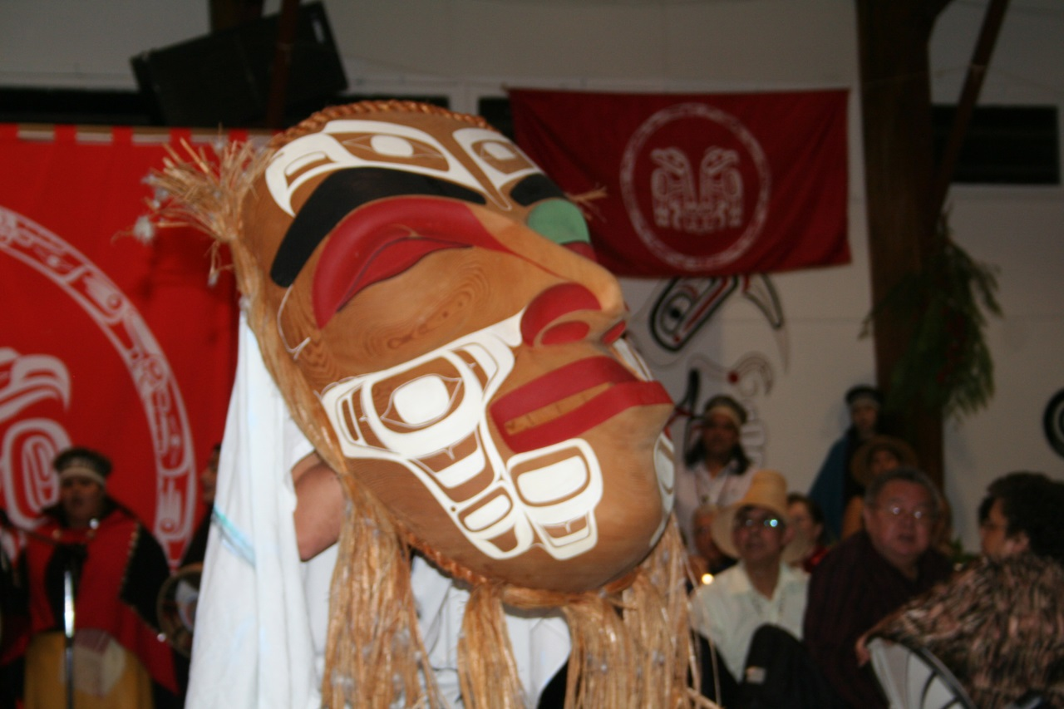
-2001 Land Use Planning/Protocol Agreement and planning process framework
-2003 Community Planning Forum/CHN/Province/Communities/Stake holders
Haida Land Use Vision
-2004 Court case: Haida Nation v. B.C. and Weyerhauser
-2005 Island Spirit Rising
Ecosystem Based Management Principles
Forest Practises Code to Forest and Range Practices Act.

Slide 4
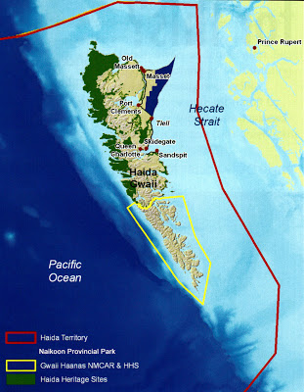
Haida Gwaii
Protected Areas

Slide 5
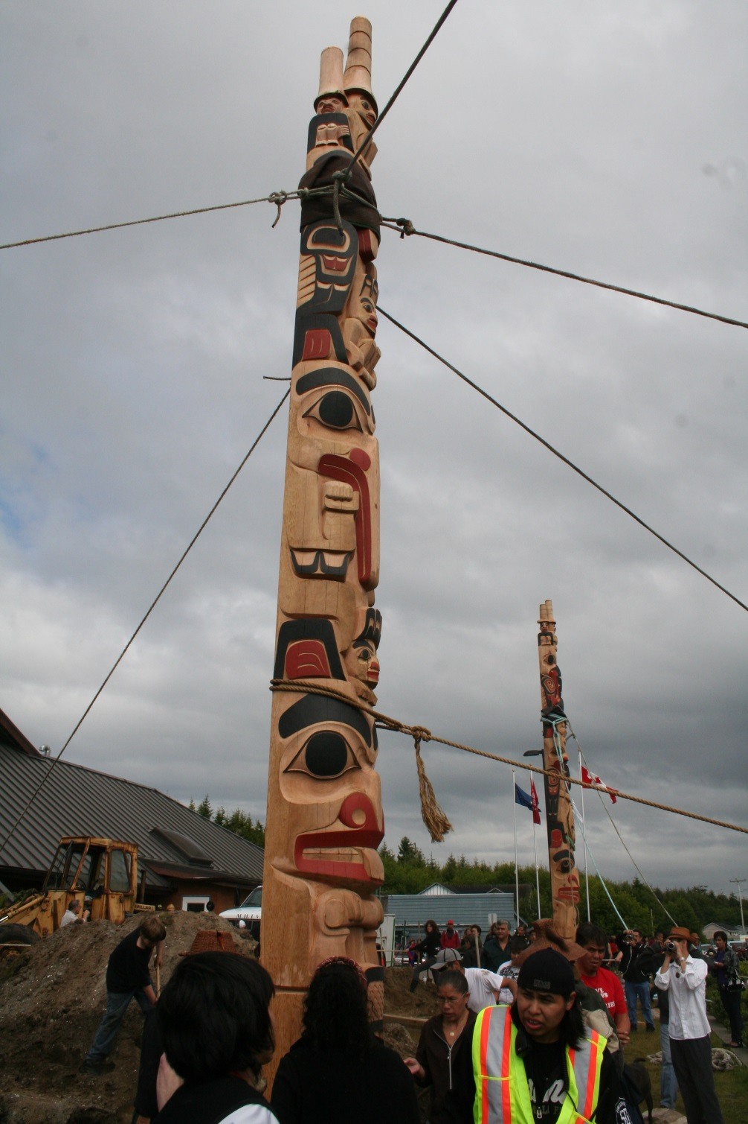
-2006 Govt. to Govt. negotiations and understanding between CHN/Province
Land Use Planning Negotiations
Timber Supply Review
-2007 Strategic Land Use Agreement
-2009 Protected Areas Established
-2010 Protected Area Management Plans
Establishment of Haida Gwaii Management Council
Haida Tenure Acquisition (TFL 60, FLTC Agreement)
Kunst’aa guu Kunst’ aayah Reconciliation Protocol
Haida Gwaii Land Use Objectives Order

Slide 6
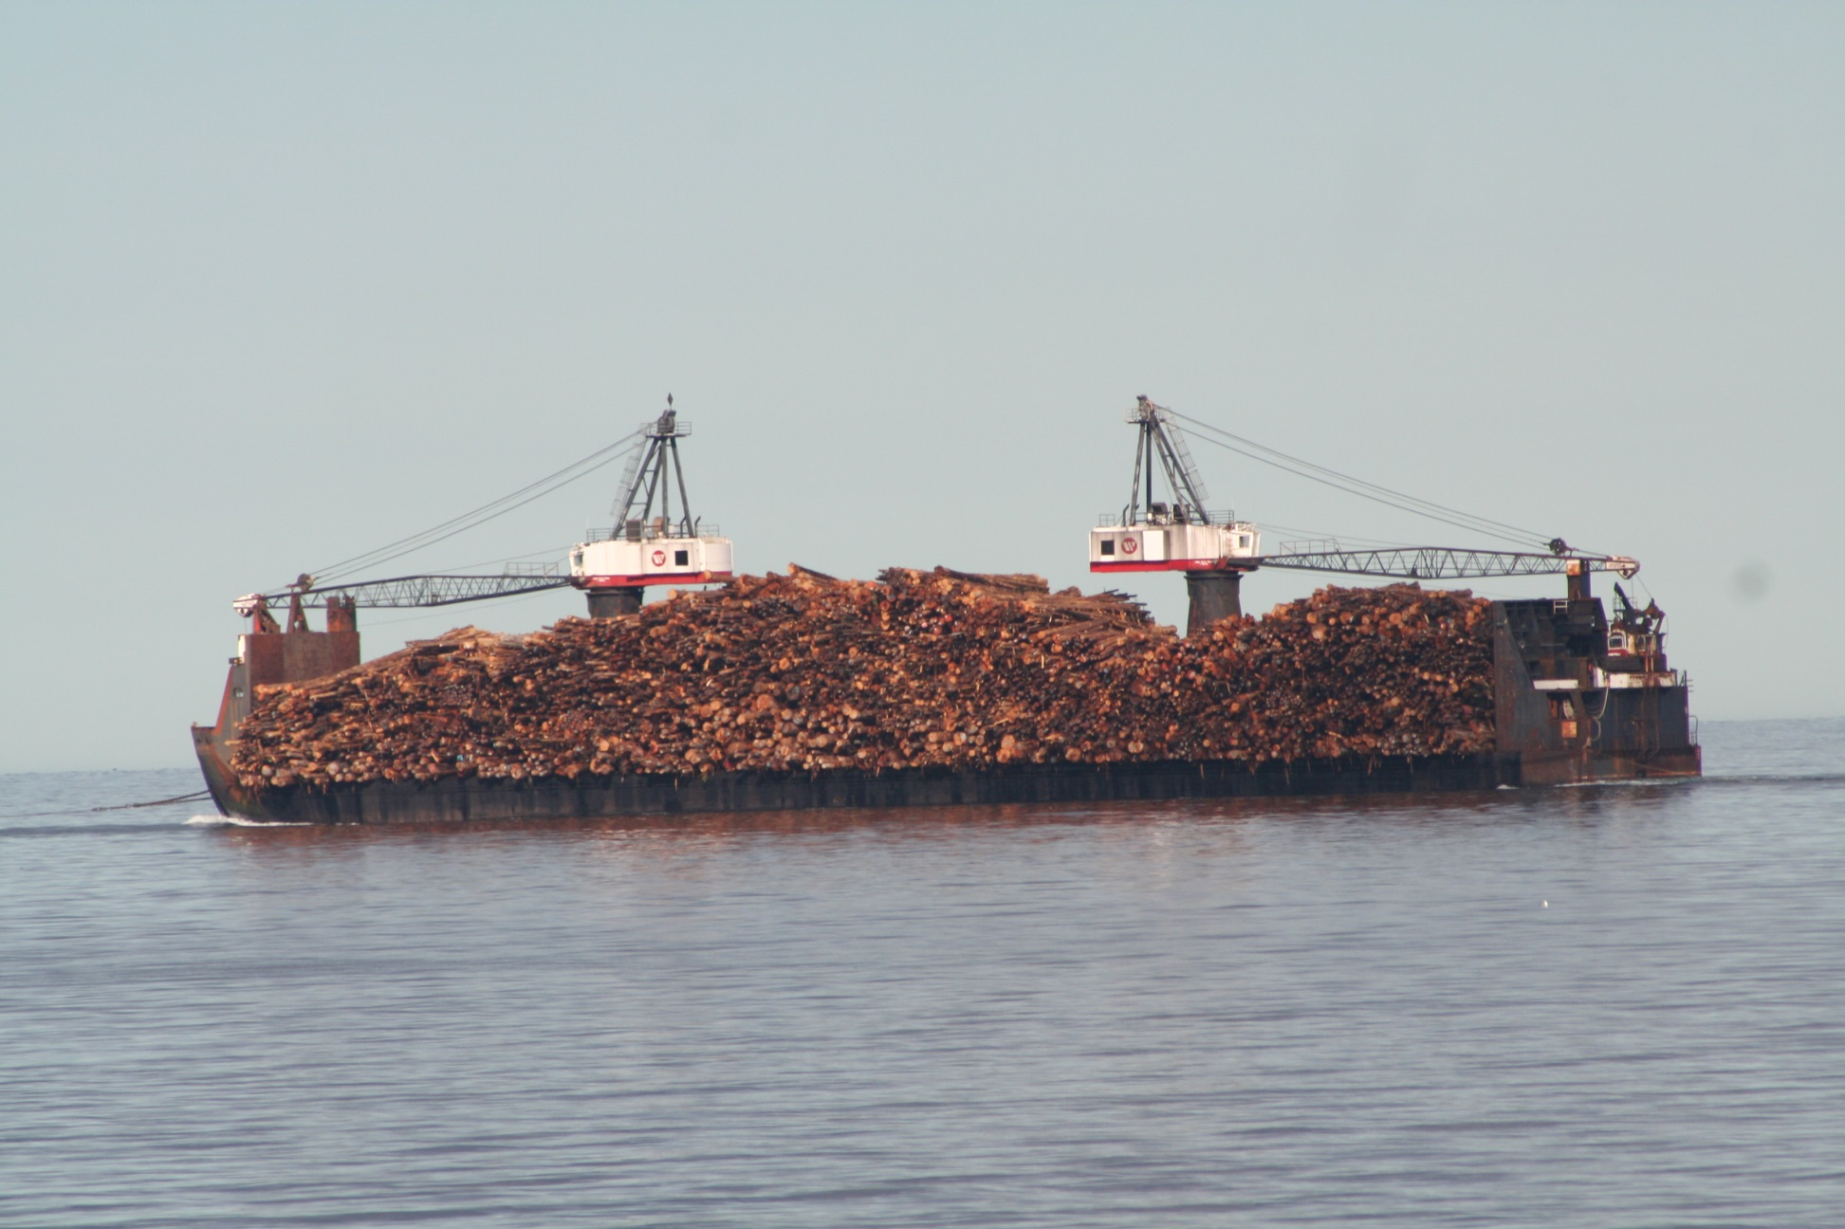
2011- 2014 Taan Forestry
Markets?
Connection from supplier to customer
Business Case
Formula

